Slide 1








Slide 2
WEB SCRAPING and EDA PROJECT
DRAFT REPORT
Vinay Amruth Paila from Batch No:- 104

Slide 3
About me
My Name is Paila Vinay Amruth. I am pursuing Bachelor of Technology in Electronics and Communication Engineering
I heard for the first time about machine learning in my 1st year of B.Tech. I started studying about the pre-requisites required for the deployment of ML model. That moment I realized the importance of the Data Science which helps in analyzing the data in a more unique and sophisticated way.
I am very much excited to start my Project as the more time I spent on analyzing data the more interesting the DataScience became to me
I am currently learning new skills and improving them in my DataScience only because of Innomatics Research Labs which facilitated with experienced mentors in that respective Field. The main thing I liked about them is the curriculam Plan and Discipline they follow and implement.

Slide 4
Steps Involved in the project :
Problem Statement:
Webscraping Data on movies from MOVIE RATINGS website and performing Exploratory Data Analysis on the Dataset.
Extract as much as possible information that can be comparable among all others.
The major Mobile features that are to be included are:
Movie Name
Year of Release
Director
Starring
Decade of Release
Ratings
#directors
#genres
Votes
Metascore or LikePrediction(%)
Gross
Duration of the movie

Slide 5
2. Search for the corresponding Data from different movie rating sites like IMDB, ROTTEN TOMATOES etc., I selected IMDB movie ratings website as it provides all the above features that can be extracted using the webscraping. Website url = https://www.imdb.com/search/title/?groups=top_1000&start=1&ref_=adv_nxt 3. Extract the data Confirm the variables (columns) which are useful to your problem statement. To do the better analysis and draw the more conclusions about your business problem it would be suggestable to scrap the minimum number of variables (columns) are 8, minimum number of rows are 400 Use Webscraping technology to extract desired information. This webscraping is done by requests and beautifulsoup libraries in the python

Slide 6
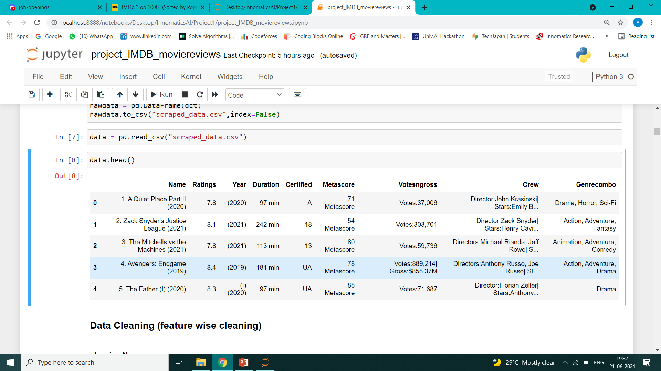
The Data right after the Webscraping :

Slide 7
Basic and Fundamental steps:- 4. Create a Data Frame to perform Data analysis on the later steps 5. Export it into .csv method 6.Read the csv file To start the Data analysis

Slide 8
7. Data cleaning: The data extracted should be cleaned into a uniform and meaningful pattern among all its examples before we start analyzing the Data. There are many methods for cleaning this data like using regex patterns and also string operations etc., And also we have to take care about removing the null values and replacing (imputing) with suitable and appropriate meaningful measures. This can be done using operations like fillna() etc.,

Slide 9
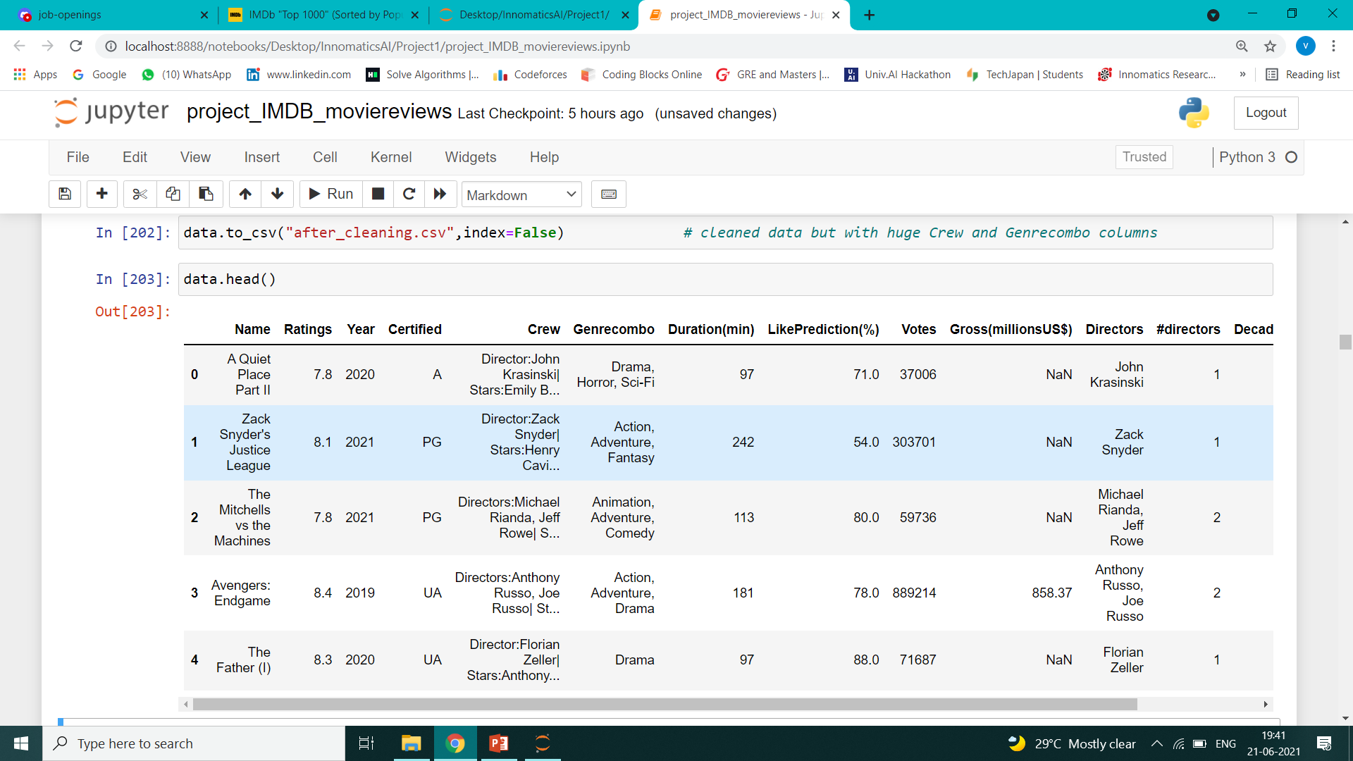
Data after the cleaning process :

Slide 10
Imputing the Null Values : (Certified, Gross(millionsUS$), LikePrediction(%) have null values) This is done by using the necessary conditions with the help of user defined functions for more accuracy not just merely replacing median or mean. The User Defined Functions are so helpful in exploring the Data in greater depths. For example the below functions that I created wil be helpful for deep analysis of each movie 1. moviesearchbyactordct(actor_name)[0/1] # creating a database for finding the name of the movie using actor names # if 0 then it gives no. of movies he acted else if 1 then it gives the movie details of that actor 2. actorsearchbymovie(movie_name) # creating a database for finding the stars of the movie using movie names 3. genrebymovie(movie_name) # creating a database for finding the genre of the movie using movie names 4. gendct # creating a dictionary for storing the frequency of all kinds of genres

Slide 11
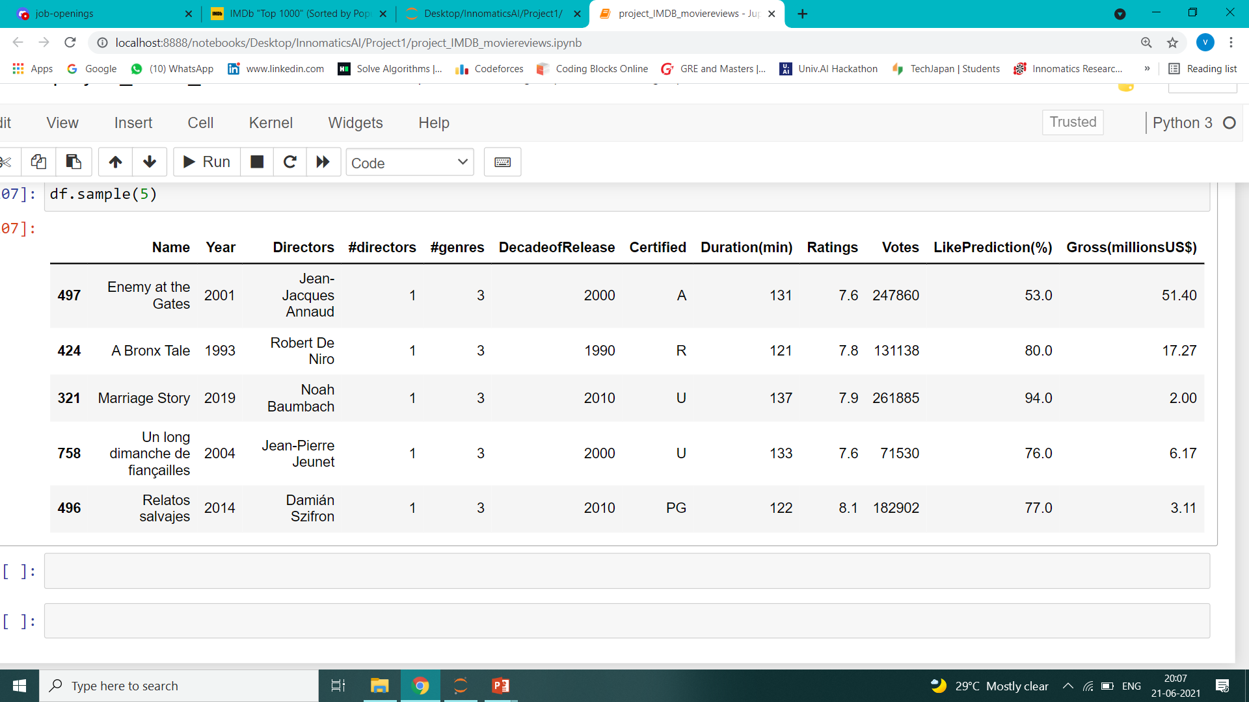
The final Dataset can be reduced by removing Crew, GenreCombo columns into the following after designing the desired functions to analyze them.

Slide 12
8. Data Analysis: - Uni-variate Analysis * Each variable should be analysed separately * The main purpose of univariate analysis is to describe the data and find patterns that exists with in it The Univariate Plots for the Categorical Plots(#directors,#genres,decadeofrelease,Certified) are: 1. bar Plot (countplot in seaborn) 2. Pie Chart - Bi-variate Analysis * Two variables should be analysed at a time * finding relation and cause and effect relation between the two * they can be num-num, num-cat, cat-cat type analysis - Multi-variate Analysis * using more than two variables to establish a relationship or find the hidden patterns. * can be done using Group by concept and describing the statistical analysis

Slide 13
9. Data Visualization (Uni, Bi and Multi-variate): Bi-variate Analysis : - Numeric to Numeric based plots: 1. Scatter Plot 2. Correlation 3. Regression analysis Here we use Scatter Plot and Correlation - Categorical to Numerical Plots: 1. ANOVA 2. 2-Y axis plot, Bar & Line charts Here we use only Bar & Line charts and 2 Y-axis plot - Categorical to Categorical Plots: 1. Chi Square Test 2. 2 Y-axis plot, Barchart 3. Heatmap (can also be applied on numerical to numerical but info is not accurately visualized) Here we use Barchart,Heatmap and 2 Y-axis plot

Slide 14
BRIEF DISCUSSION on UNIVARIATE ANALYSIS:- (10) A FEW INTERPRETATIONS: Let us see some Observations in Visuals to understand the relations in a better way

Slide 15
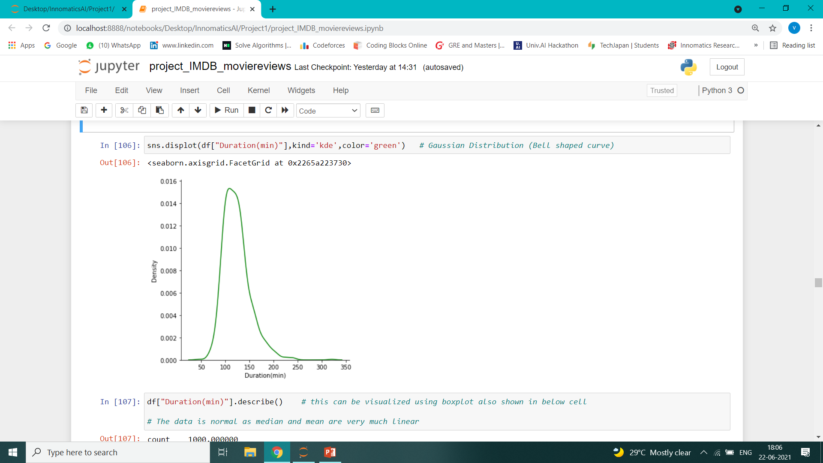
Observation 1. The Duration(min) of 500 films(50 percent of the data) is lies between 100 to 140 minutes 50% data (500 movies) Duration(min) are in the range of 103 min to 137 min with a median of 119 the mean of all the duration(min) of the movies = 123.19 So,the data is normally distributed(Bell shaped) with only 15 outliers

Slide 16
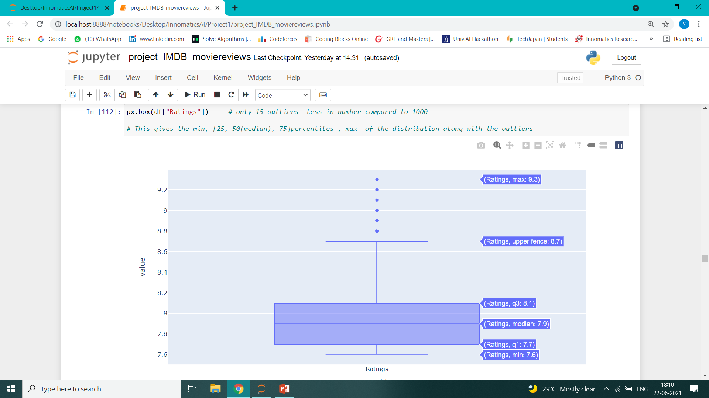
Observation 2. This box plot shows that 7.9 is the median of the data with 6 outliers out of 1000 50% data (500 movies) ratings are in the range of 7.7 to 8.1 the mean of all the ratings = 7.95 So the data is normally distributed without any skewness

Slide 17
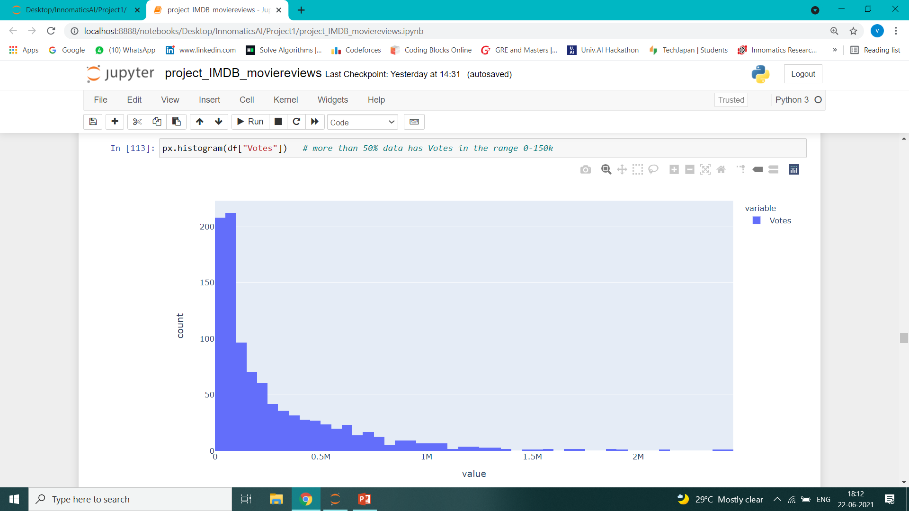
Observation 3. The Distribution of the Votes is right skewed (+vely skewed) as mean > median¶ with 50% data (500 movies) having votes from 55.82k to 382.589k as the data is right skewed, there will be presence of outliers above the upper fence

Slide 18
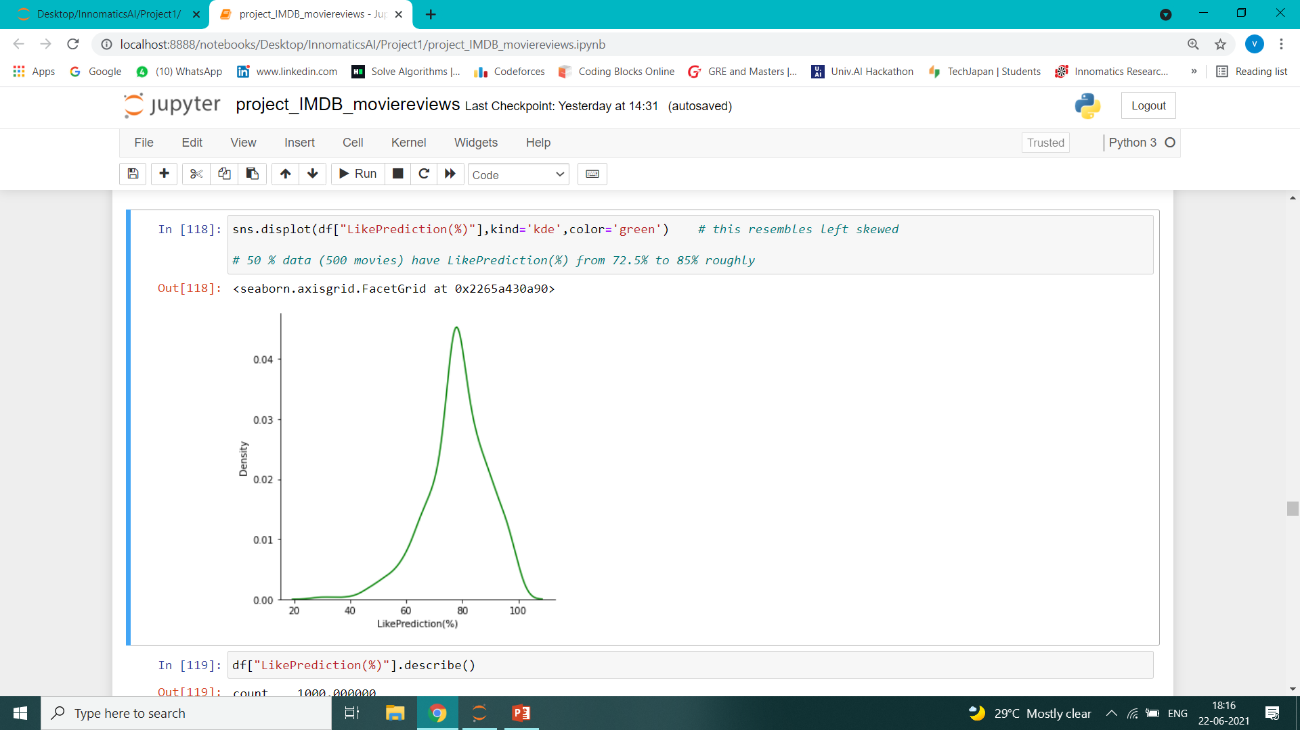
Observation 4 : The Distribution of the LikePrediction(%) is left skewed with normal distribution with 50% data (500 movies) having LikePrediction(%) from 72% to 86% as the data is left skewed, there will be presence of outliers below the lower fence

Slide 19
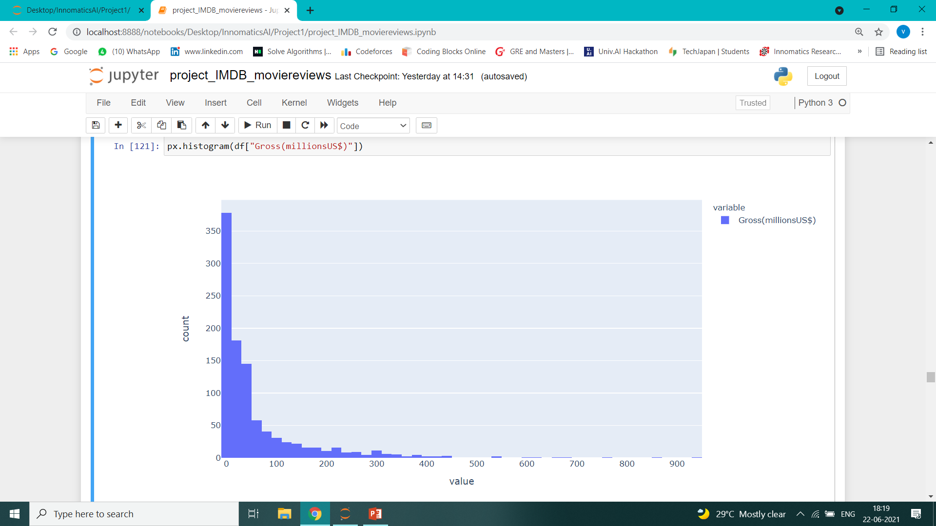
Observation 5. The Distribution of the Gross(millionsUS$) is right skewed (+vely skewed) as mean > median with 50% data (500 movies) having votes from 3.875 to 61.575 as the data is right skewed, there will be presence of outliers above the upper fence (evident that only a few number of movies gain a lot of profits)

Slide 20
BRIEF DISCUSSION on BIVARIATE ANALYSIS: (10) A FEW INTERPRETATIONS: Let us see some Observations in Visuals to understand the relations in a better way

Slide 21
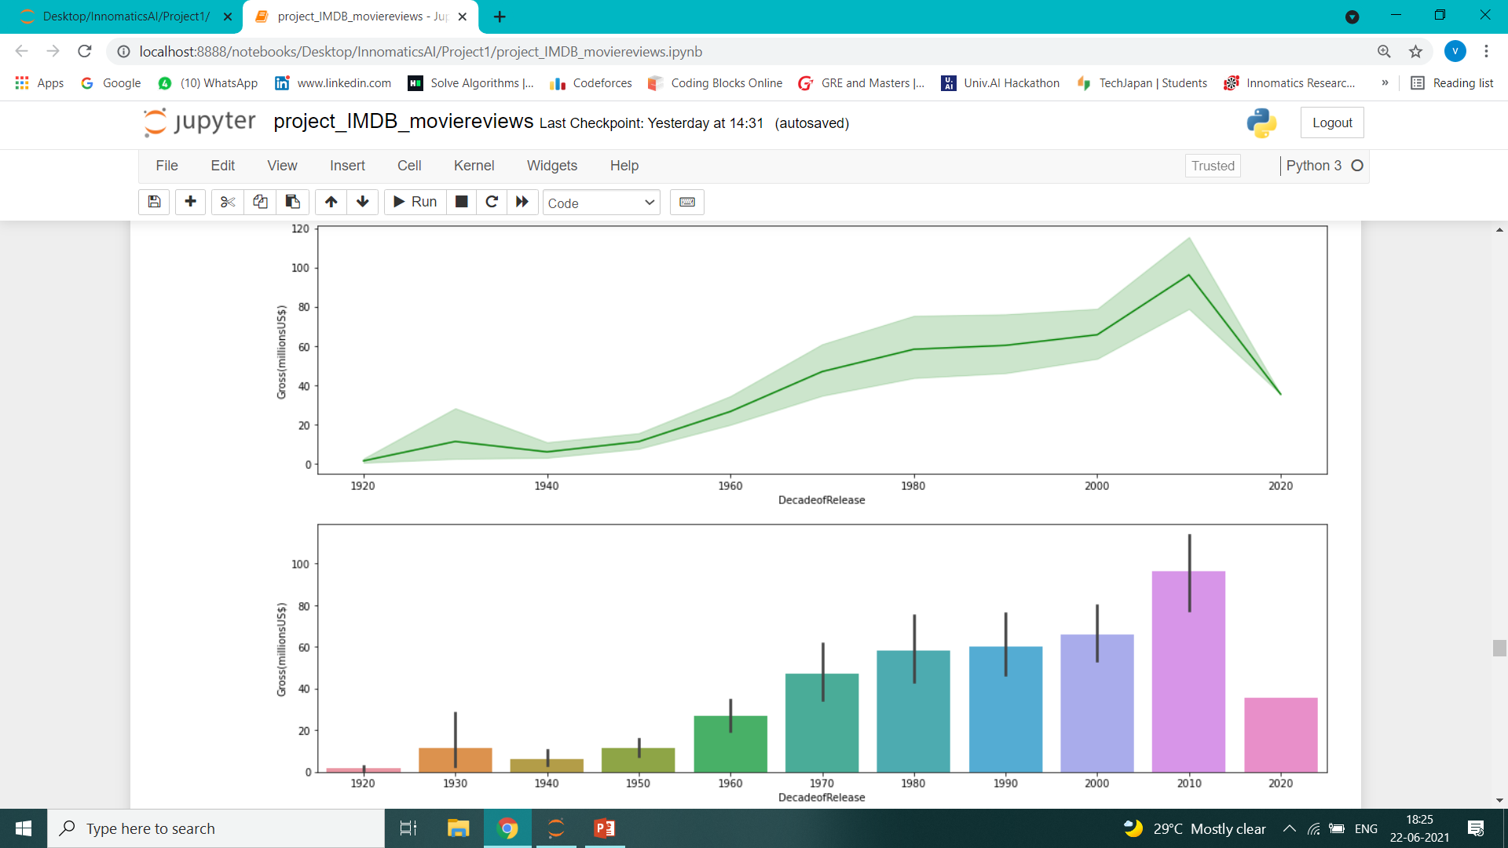
Observation 1 : The 2020 is the present decade with one year passed and that to with covid so it depicts less number of box office collections. Relationship between DecadeofRelease and Gross(millionsinUS$)

Slide 22
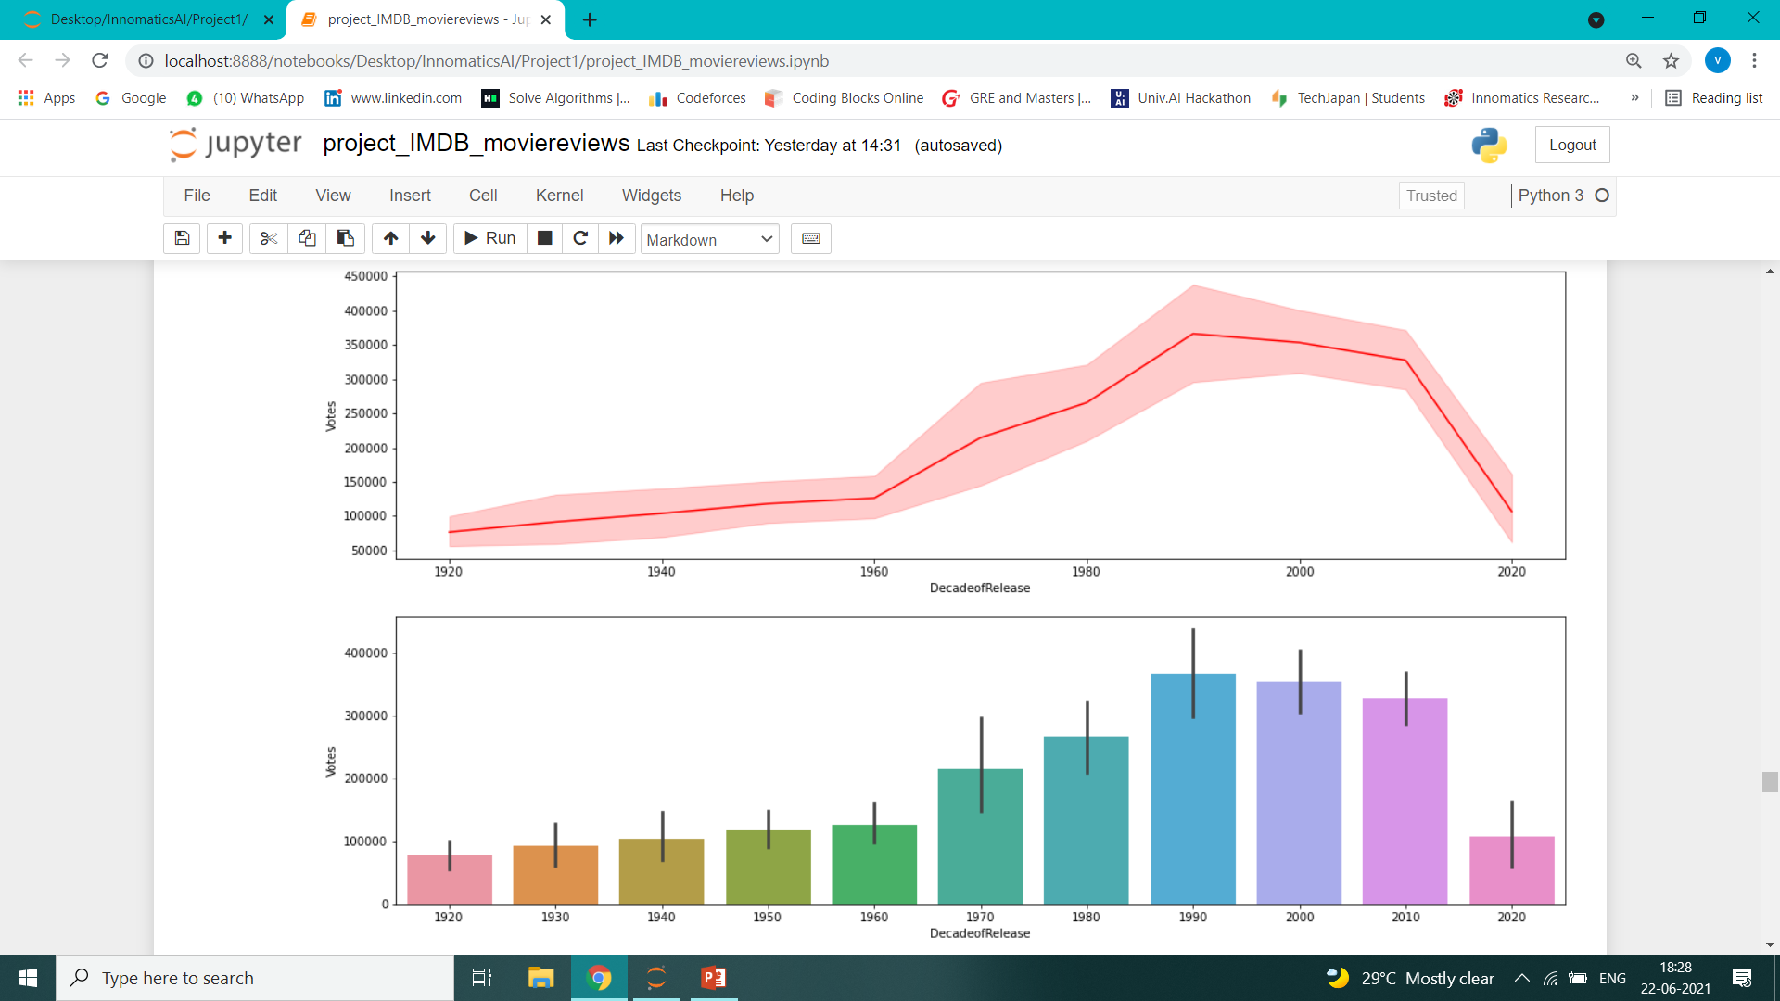
Observation 2 : The no. of votes have increased siginificantly at the end of the 20 th century (1990 decade) but later it declines till the 2020s Relation b/w DecadeofRelease and Votes

Slide 23
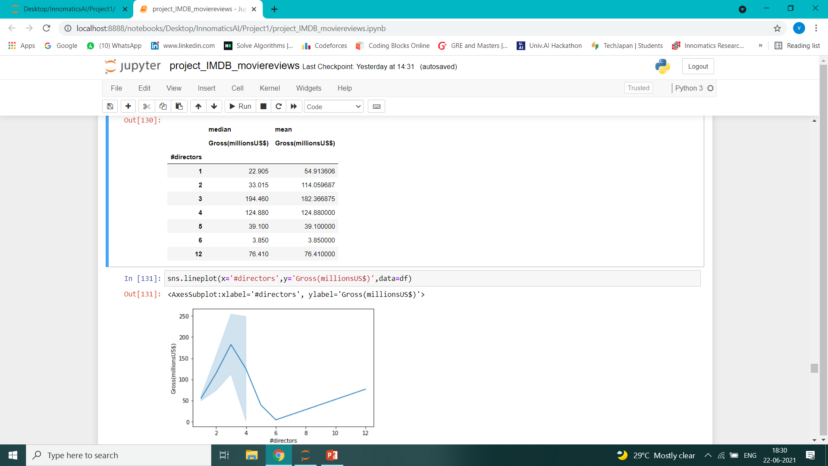
Observation 3 : This trend shows that atmost of having 3 directors resulted in achieving higher Gross. The movies with 3 directors yield large box office colections that can be seen from the plot Relation b/w #directors and Gross(millionsUS$)

Slide 24
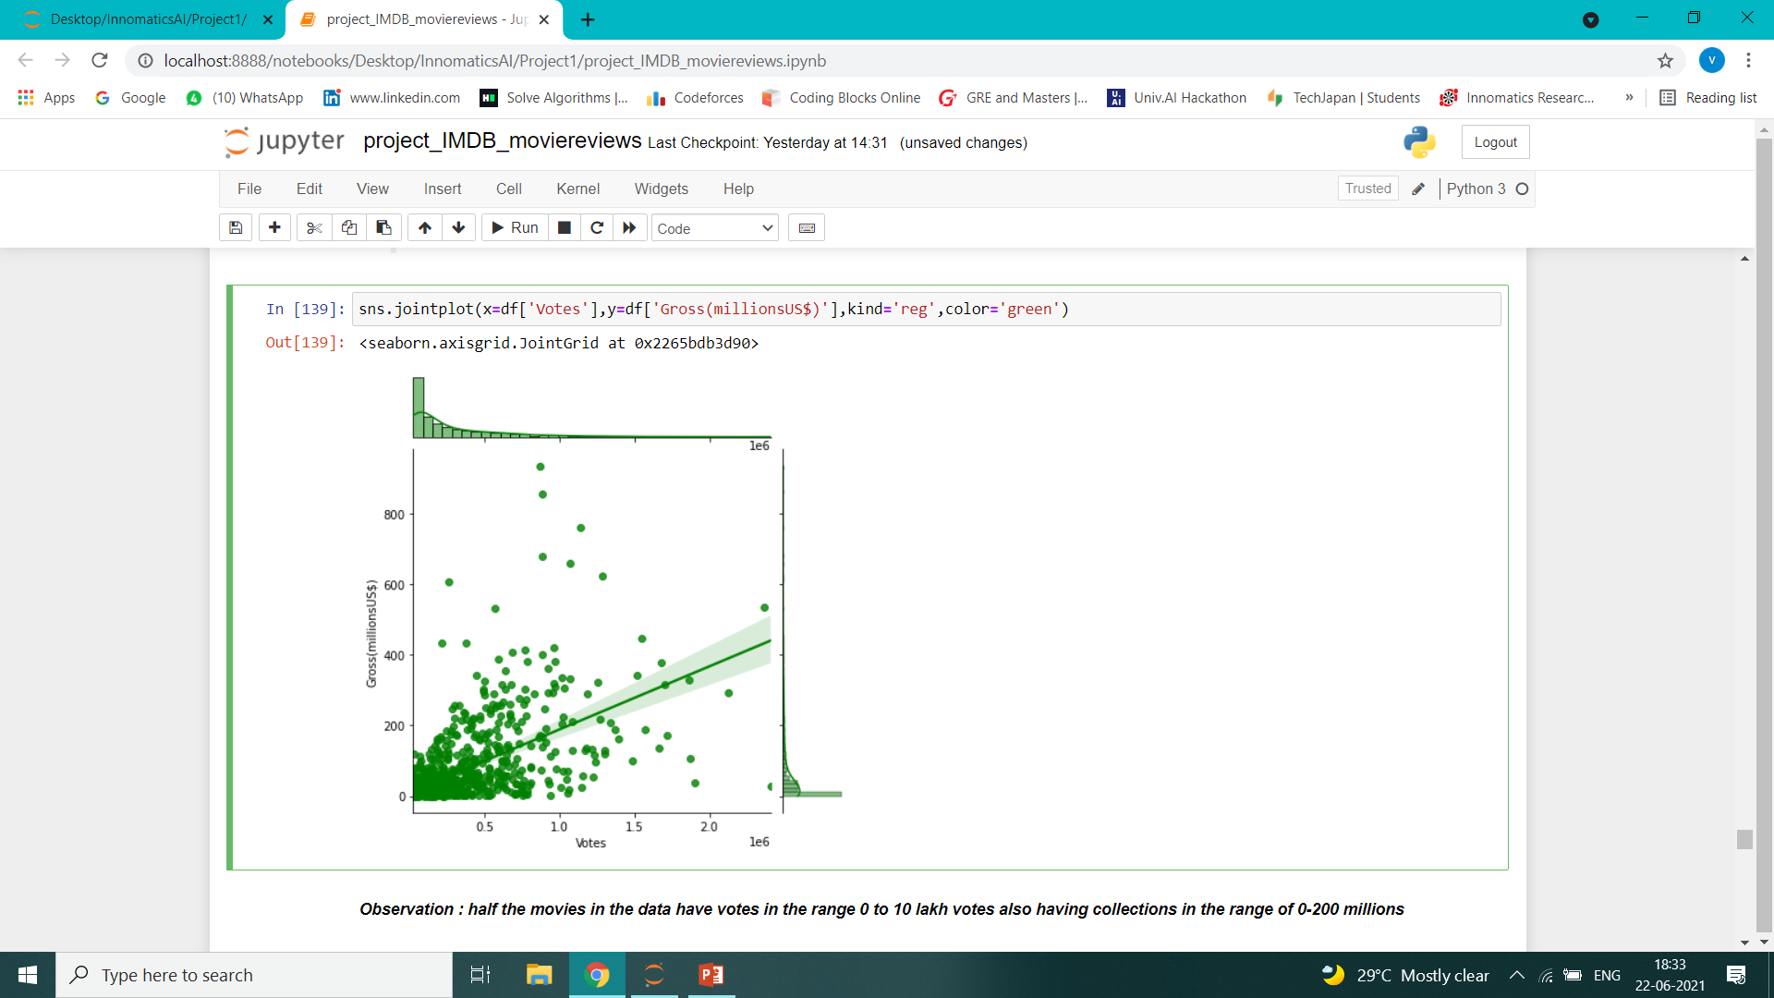
Observation 4: half the movies in the data have votes in the range 0 to 10 lakh votes also having collections in the range of 0-200 millions Analysis of Votes and Gross(millionsUS$)

Slide 25
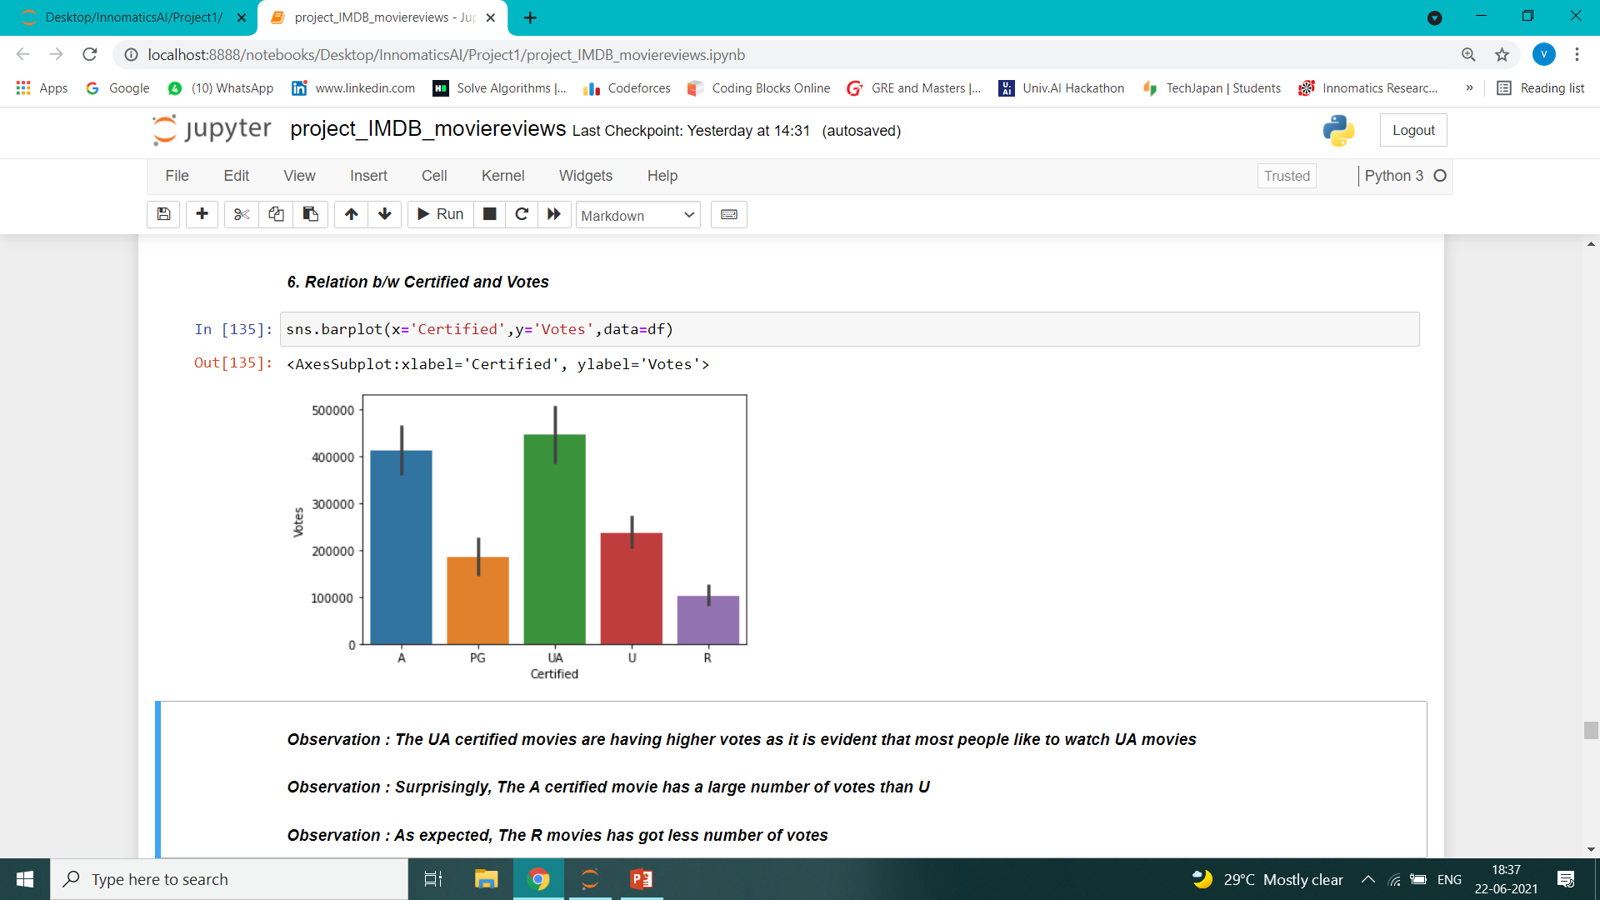
Observation 5: (1)The UA certified movies are having higher votes as it is evident that most people like to watch UA movies (2) Surprisingly, The A certified movie has a large number of votes than U (3) As expected, The R movies has got less number of votes Relation b/w Certified and Votes

Slide 26
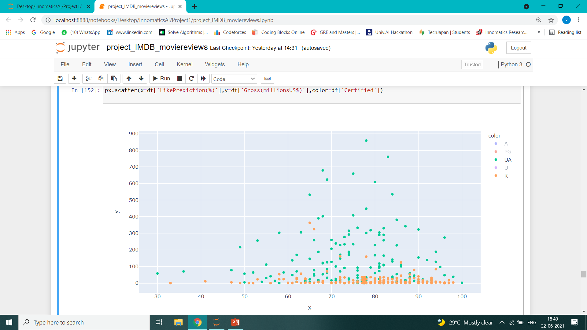
Observation 6: (1) The movies with(70% to 90%)LikePrediction(%) and R certificate having low Gross(millionsUS$) (2) The movies with(60% to 90%)LikePrediction(%) and UA certificate having high Gross(millionsUS$) Relation between LikePrediction(%) and Gross(millionsUS$)
= Gross(millions in US$)
= Like Prediction(%)

Slide 27
BRIEF DISCUSSION on MULTIVARIATE ANALYSIS: * using more than two variables to establish a relationship or find the hidden patterns. * can be done using Group by concept and describing the statistical analysis (10) A FEW INTERPRETATIONS: Let us see some Observations in Visuals to understand the relations in a better way

Slide 28
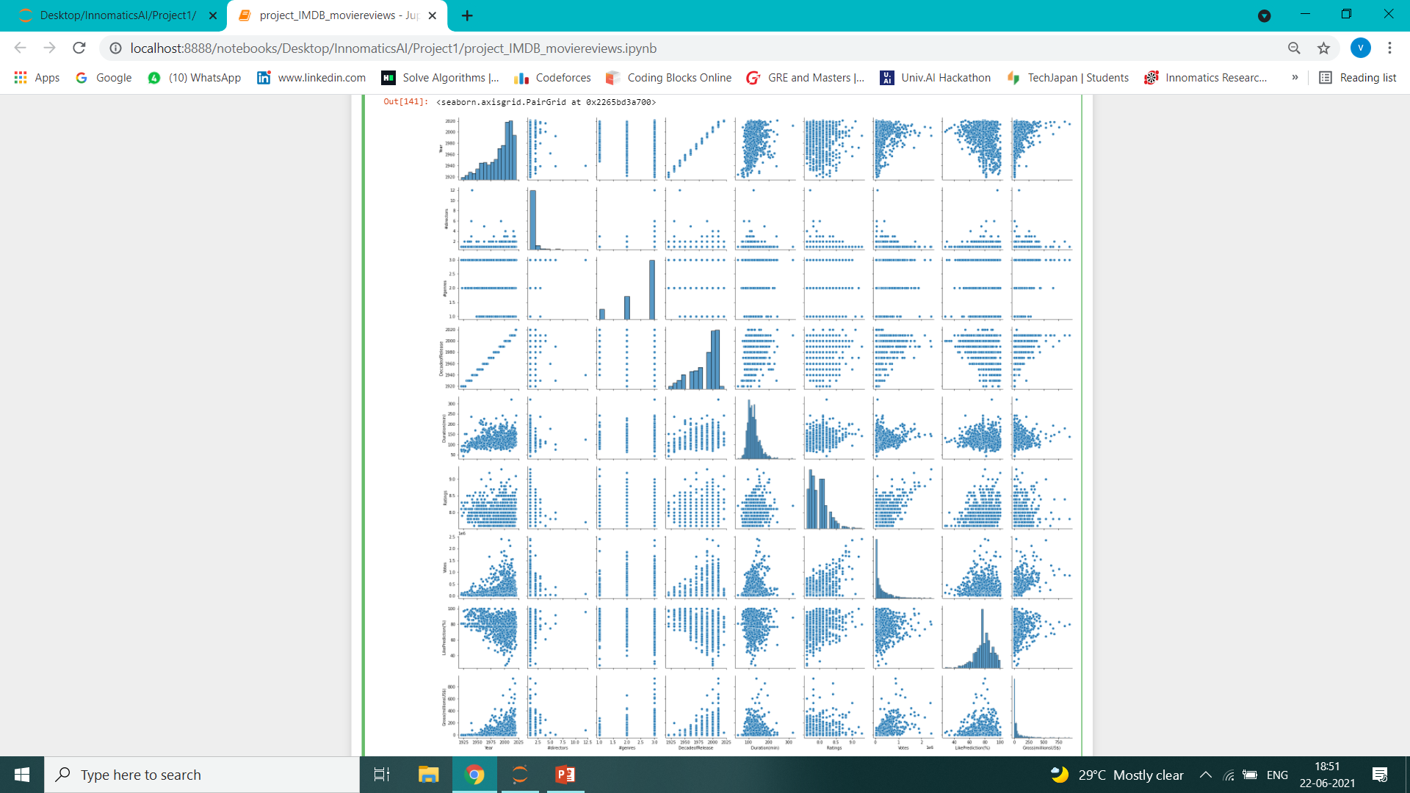
(1) using pairplot() we can find the variations with in all the features Rough Estimation of plot between all features

Slide 29
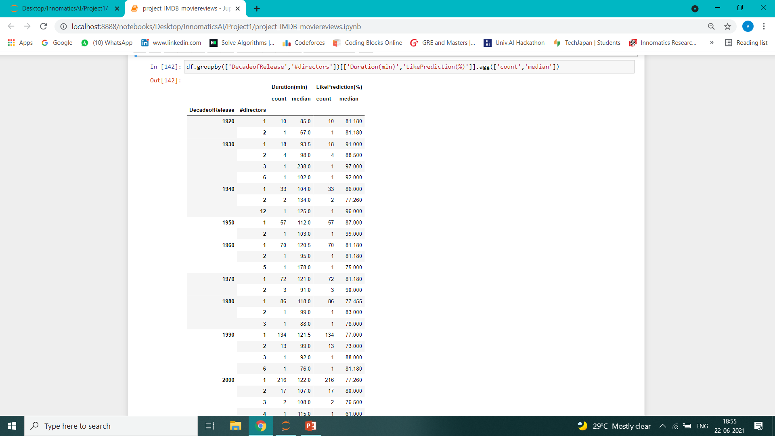
(2a) using pivot_table() or groupby() , we can summarize the data between the multiple features example relationship and Analysis of the four variables : DecadeofRelease, #directors, Duration(min), LikePrediction(%)

Slide 30
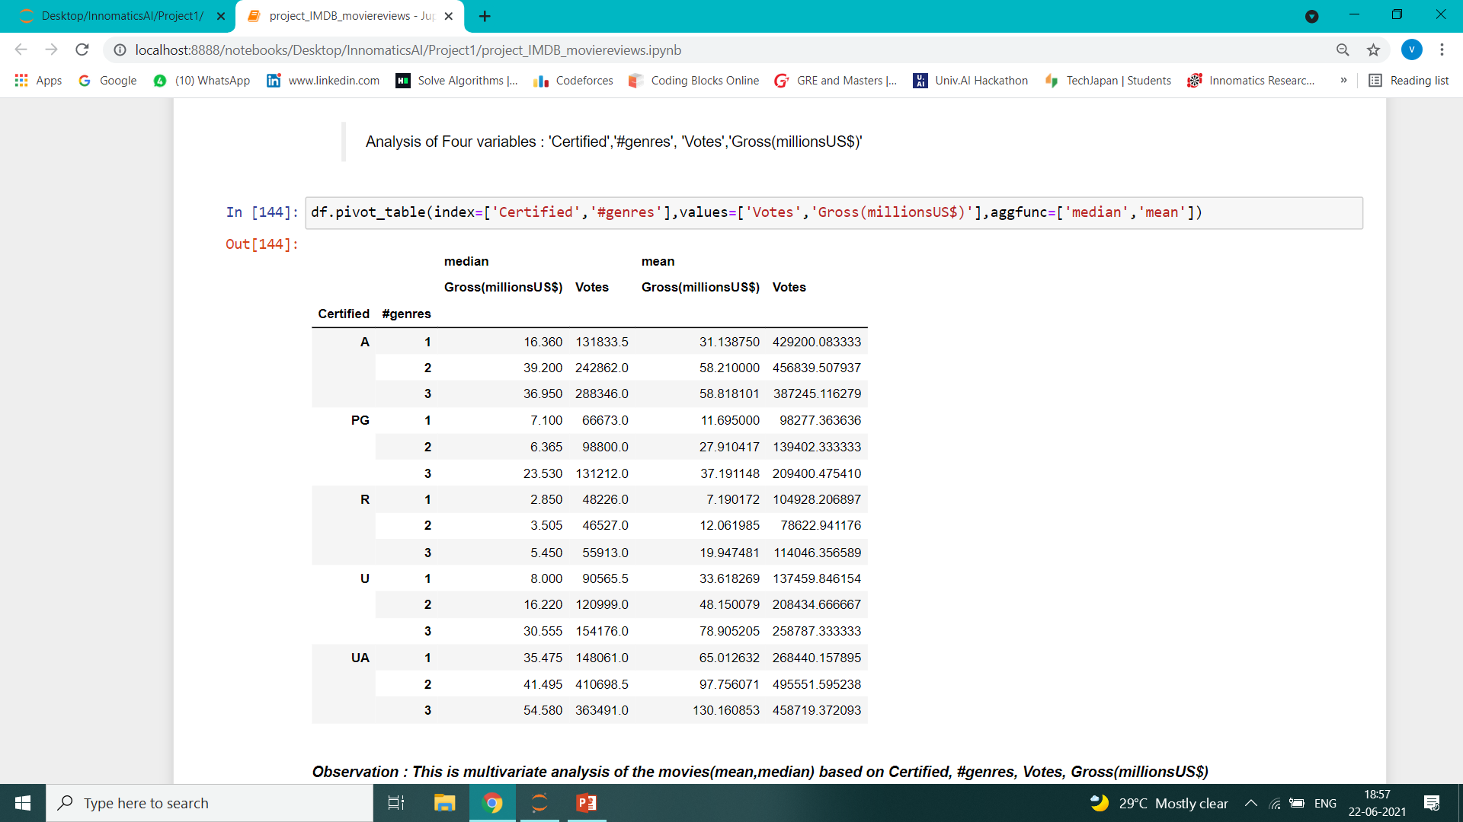
(2b) Using pivot_table() for the analysis of multiple variable as shown below :

Slide 31
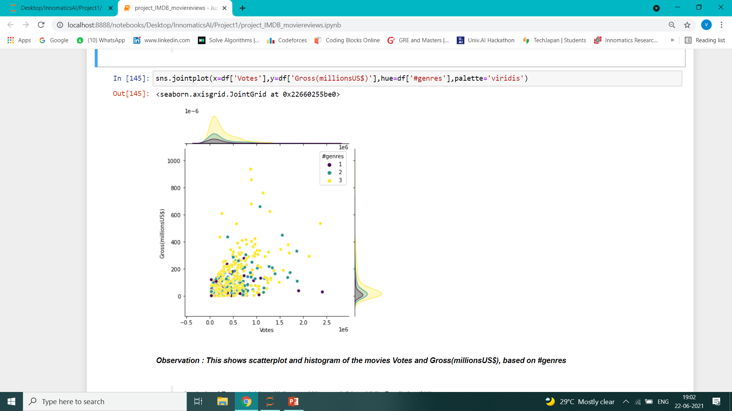
(3) we can also use jointplot() with passing hue argument as some categorical feature for trivariate analysis.

Slide 32
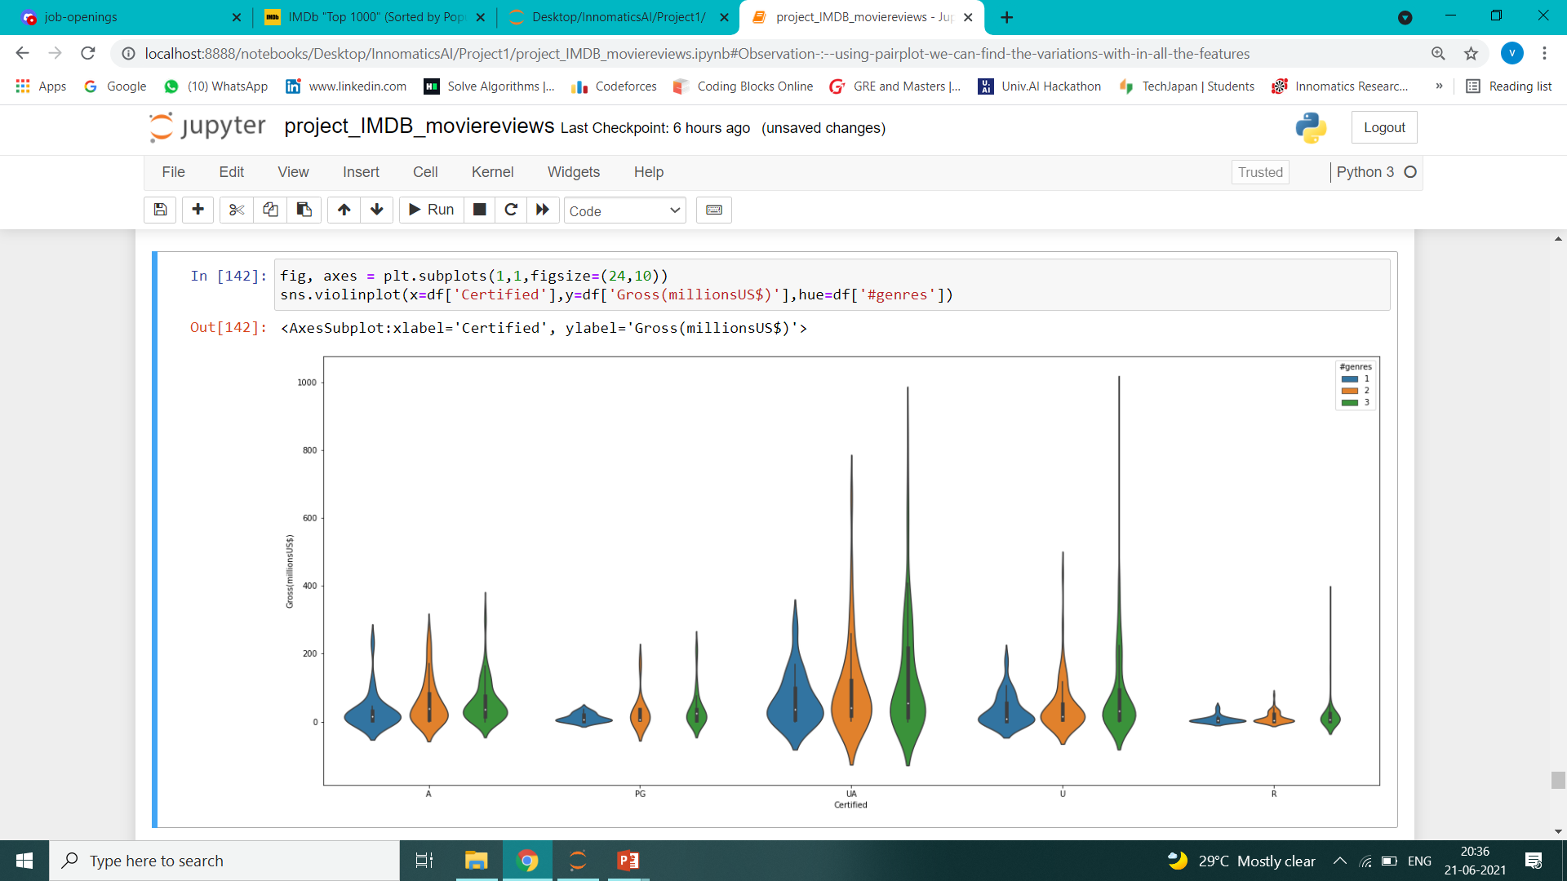
(4) : This is the Violin Plot which shows the distribution of the Gross(millionsUS$) based on the certifications The larger the tails of the Distribution the more the data is skewed

Slide 33
11. The Conclusions that can be drawn from IMDB Movie Ratings and collections Data of 1000 movies: Some important Conclusions are as shown:- Most of the movies in the data have ratings 7.7, 7.8, 8, 8.1 . The movies with 3 number of directors yield good Gross (Box Office Collections) Most of the Movies(50% data) have votes in the range 0 to 10 lakhs with gross 0 to 200 millions The UA certified films are earning more Gross. If we drill down more the UA movies with 3 directors yield more Gross than 1,2 no. of directors The movies with(70% to 90%)LikePrediction(%) and R certificate having low Gross(millionsUS$) The movies with(60% to 90%)LikePrediction(%) and UA certificate having high Gross(millionsUS$) As the Decade passes by, The Gross and the no. of movies released are increasing steeply ------------------------------------------------XXXXXXXXXXXXXXX-------------------------------------------------------------------
Vinay Amruth Paila - batch 104

Slide 34

THANK YOU

